Slide 1

StudyMate: Your AI-Powered Academic Assistant

Slide 2
INTRODUCTION
StudyMate is an innovative AI-powered academic assistant designed to revolutionize how university students interact with their study materials. By transforming static PDFs into dynamic, interactive learning companions, StudyMate streamlines the research and revision process, making academic pursuits more efficient and engaging.
Interact with PDF study materials through natural-language Q&A.
Supports textbooks, lecture notes, and research papers.
Eliminates manual searching, providing direct, contextual answers.

Slide 3
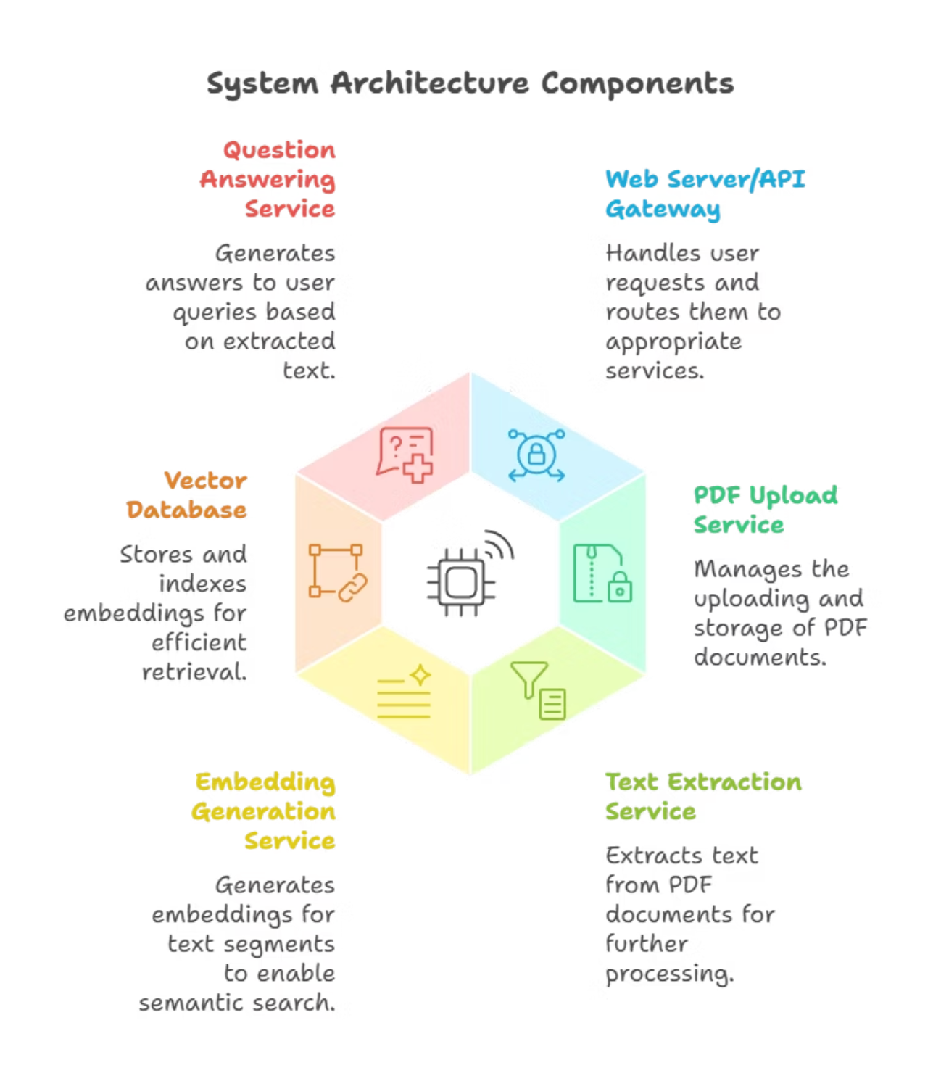
ARCHITECTURE of STUDYMATE
StudyMate AI uses a document ingestion pipeline (PDFs, slides, notes) with OCR + text parsing, which stores embeddings in a Vector DB (FAISS/Pinecone) for fast retrieval. A RAG layer combines retrieved context with LLM models (OpenAI/Mistral/HuggingFace) to answer queries, summarize, and generate flashcards. Additional TTS/Audio services create narrated slides, while a web/mobile client interacts via an API layer with secure auth and scalable storage.

Slide 4
SOLUTIONS
Conversational Q&A
1
Engage with your study materials using natural language queries, just like talking to a tutor.
Accurate Text Extraction
2
PyMuPDF ensures high-quality text chunking, preserving formatting and context for precise answers.
Semantic Search
3
FAISS and SentenceTransformers retrieve the most relevant content, understanding the meaning behind your questions.
LLM-Based Generation
4
Leveraging IBM Watsonx (Mixtral-8x7B-Instruct), StudyMate generates grounded answers with verifiable citations.
User-Friendly Interface
5
A clean Streamlit interface provides a seamless experience for uploading documents, asking questions, and visualizing results.

Slide 5










FUTURE SCOPE
Multilingual Support
Multi-Document Knowledge Graph
Expand accessibility by providing answers in various languages, catering to a global student body.
Connect insights across multiple PDFs, building a comprehensive knowledge base.
Voice-Enabled Q&A
Integrate Text-to-Speech (TTS) and Speech-to-Text (STT) for hands-free, intuitive learning.
Mobile + Cloud Deployment
Ensure anytime, anywhere accessibility with robust mobile applications and cloud infrastructure.
Collaboration Features
Enable shared Q&A sessions, fostering peer-to-peer learning and discussion.

Slide 6

CONCLUSION
StudyMate isn't just an app; it's a paradigm shift in academic support. By harnessing the power of advanced AI, it transforms how students engage with their coursework, fostering deeper understanding and greater academic success.
Transforms static PDFs into interactive learning companions.
Boosts student productivity and comprehension.
Provides accurate, contextual answers with references.
A scalable, AI-driven solution for modern education.

Slide 7
THANK YOU

